Slide 1



Exploratory Data Analysis (EDA) for Real Estate Pricing: Unveiling the Dynamics of House Valuation in a Dynamic Market
F i n a l P r o j e c t P r e s e n t a t i o n
Nexthikes IT Solutions
Presented by: Sonal Patel

Slide 2
Introduction
Problem Statement:
Pricing residential properties accurately in a competitive real estate market is complex and influenced by multiple factors. The objective of this analysis is to identify and understand the key variables that significantly impact house prices using data analytics and visualization techniques, enabling informed and strategic pricing decisions.
Situation Overview:
The real estate market is shaped by diverse factors such as location, property characteristics, amenities, and historical trends. This analysis focuses on extracting meaningful insights from the dataset by examining relationships, patterns, and outliers using statistical and visual methods. The findings aim to support data-driven pricing strategies, improve decision-making, and help the company gain a competitive advantage in the market.

Slide 3
Objectives
1. Loading the Data:
Load the real estate pricing dataset into a Pandas DataFrame.
Load the dataset provided in a CSV or Excel format into a Pandas.
DataFrame to facilitate easy manipulation and analysis.
2. Cleaning the Data:
Clean the dataset by handling missing values, removing duplicates, and addressing any anomalies.
Ensure data quality by eliminating missing values, removing duplicate entries, and addressing any anomalies or inconsistencies in the dataset.
3. Univariate Analysis:
Explore individual variables to understand their distributions and characteristics.
Conduct a univariate analysis to understand the distribution of key variables like house prices.
Utilize histograms, kernel density plots, or other visualizations to gain insights into the data.
4. Multivariate Analysis:
Investigate relationships between multiple variables, especially those impacting house prices.
Perform multivariate analysis to understand the correlations and dependencies between various features. Utilize techniques like correlation matrices or scatterplot matrices for a comprehensive view.

Slide 4

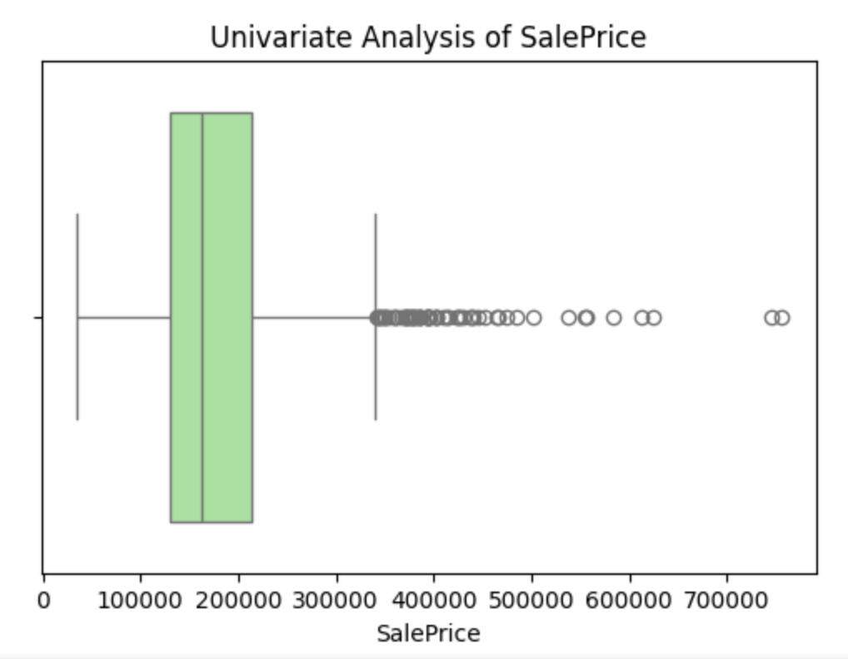
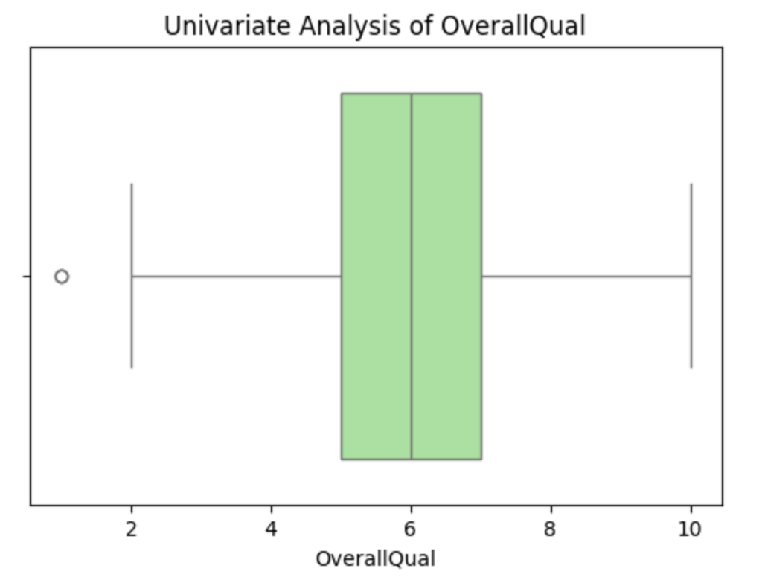
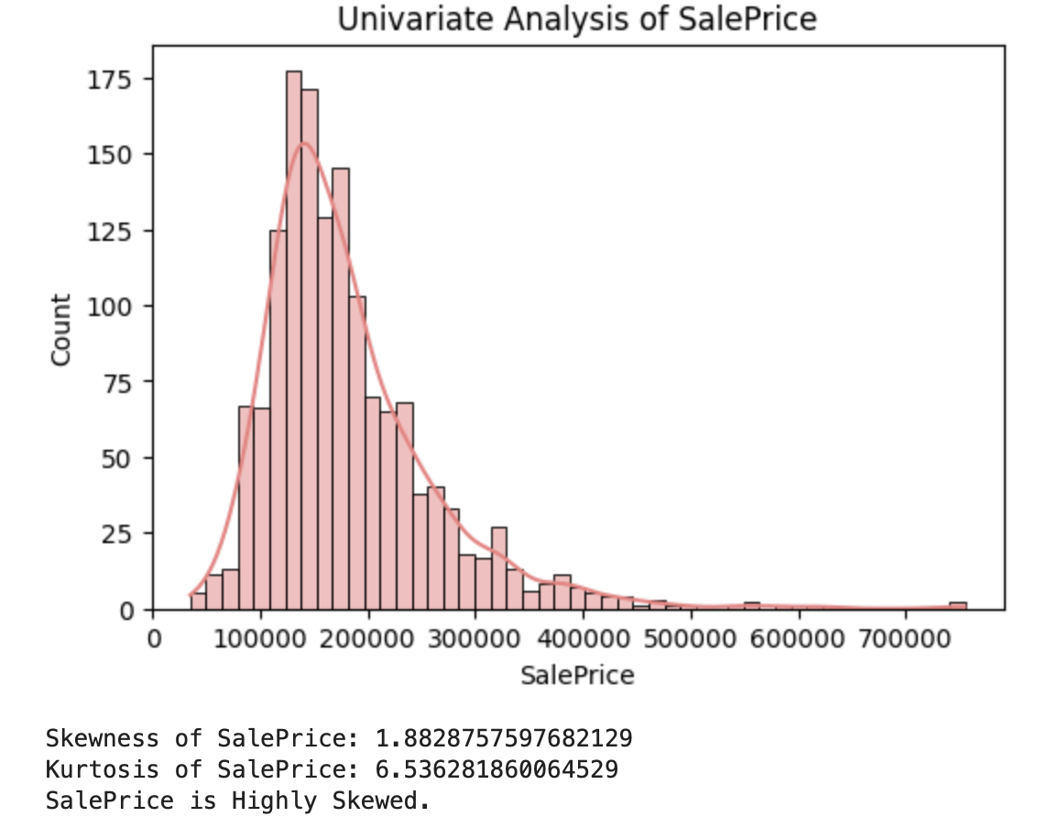
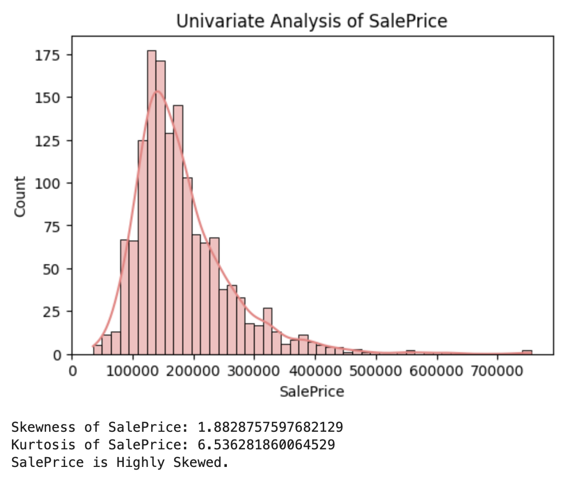
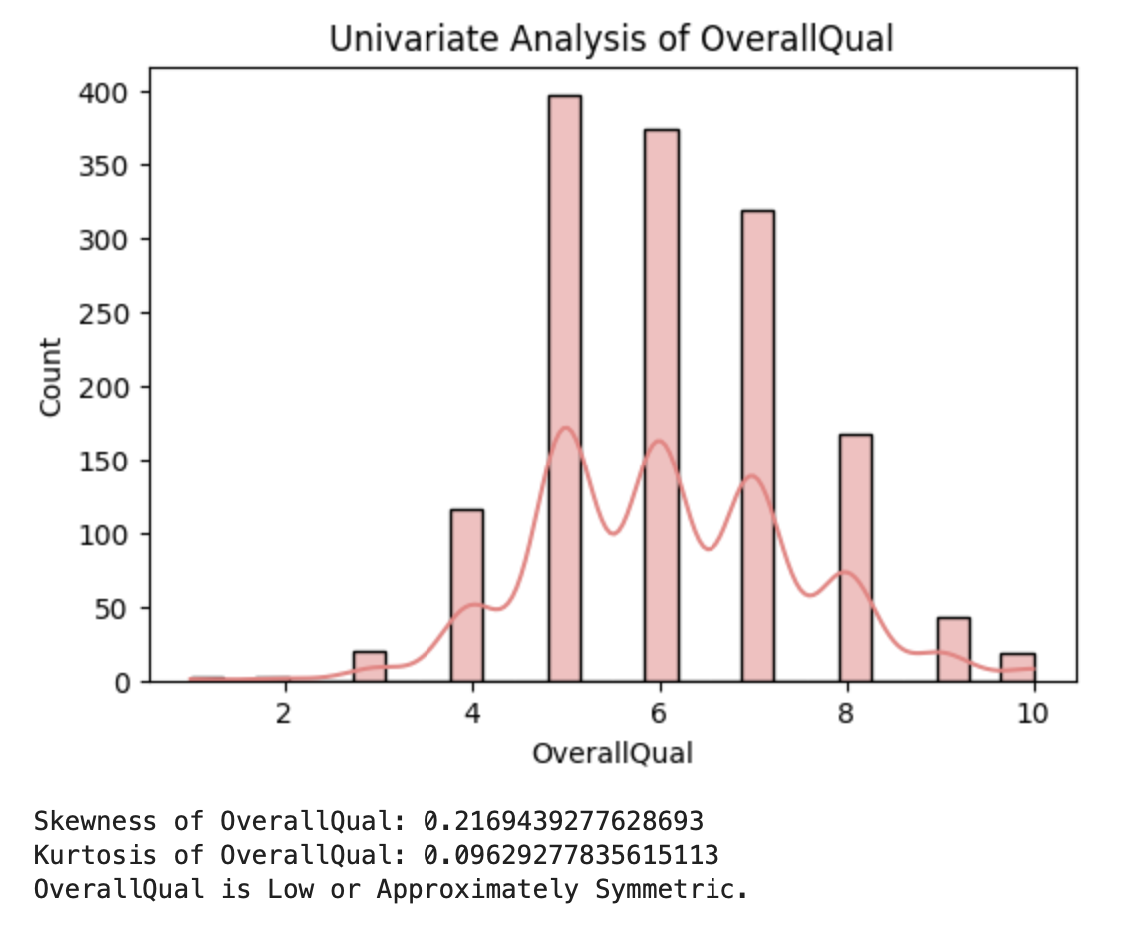

Univariate Analysis
1. SalePrice
Observed Pattern: Right-skewed distribution
Unusual Observations: High-end luxury outliers
Insight: Majority of homes fall in mid-price range with few premium properties
2. OverallQual
Observed Pattern: Peak around average to good quality ratings
Unusual Observations: Very few extremely low or high-quality homes
Insight: Most houses are reasonably well constructed

Slide 5
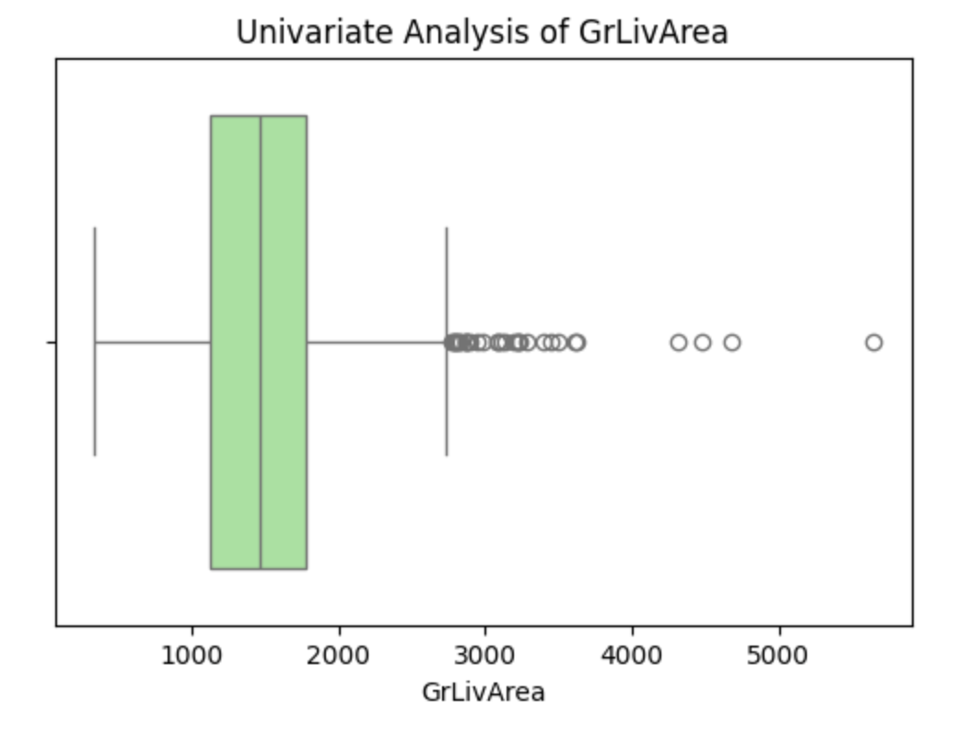
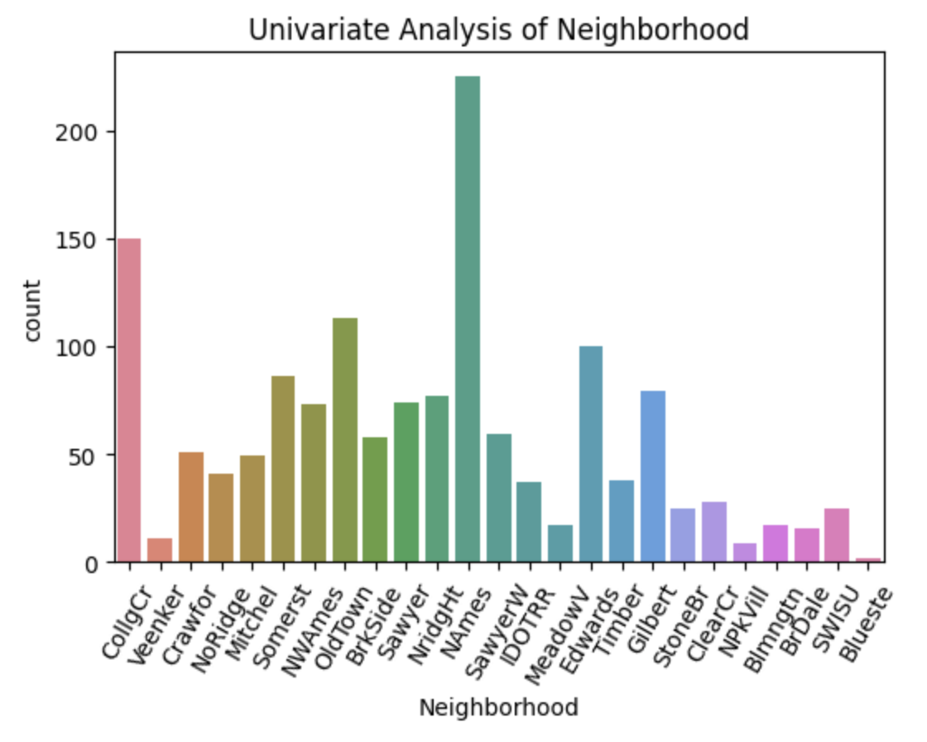
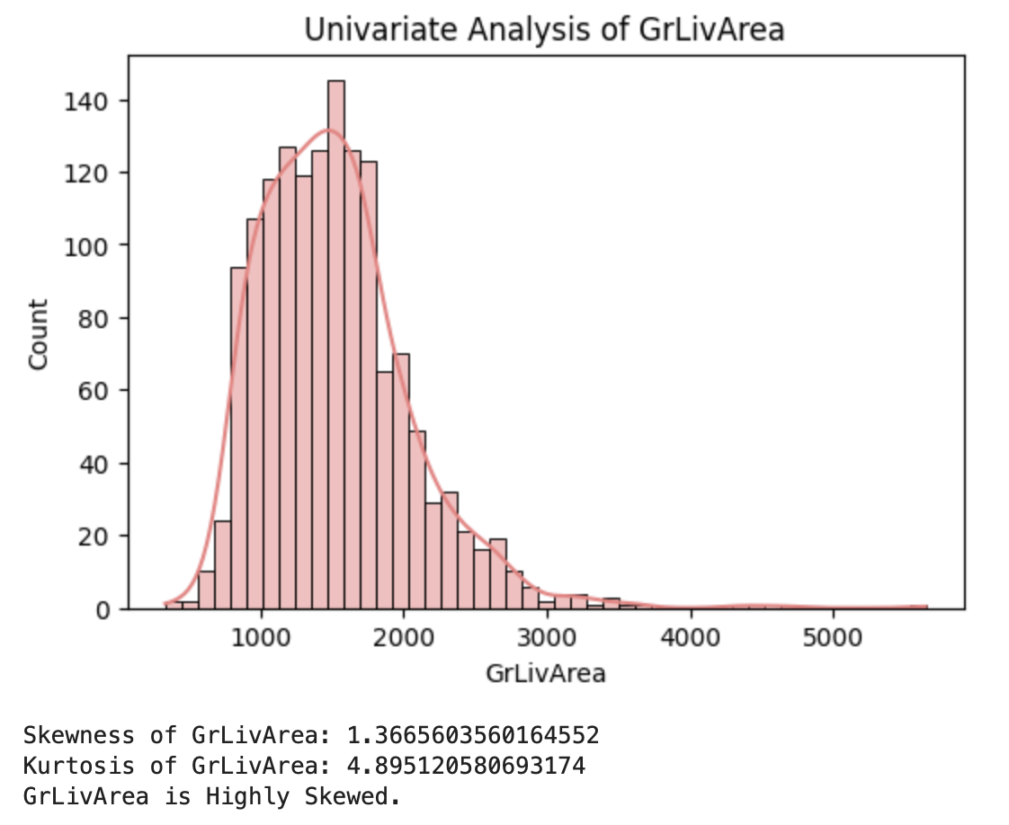
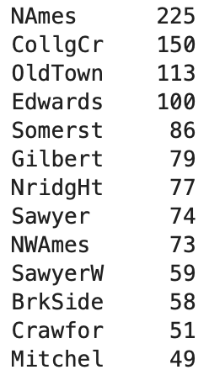
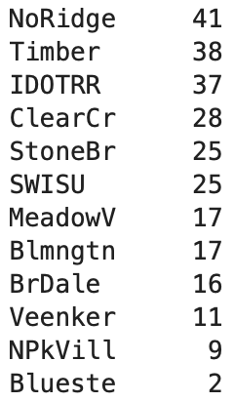
3. GrLivArea
Observed Pattern: Peak around average to good quality ratings
Unusual Observations: Very few extremely low or high-quality homes
Insight: Most houses are reasonably well constructed
4. Neighborhood
Observed Pattern: Uneven distribution across neighborhoods
Unusual Observations: Some neighborhoods have very low representation
Insight: Certain locations are more active housing markets than others

Slide 6
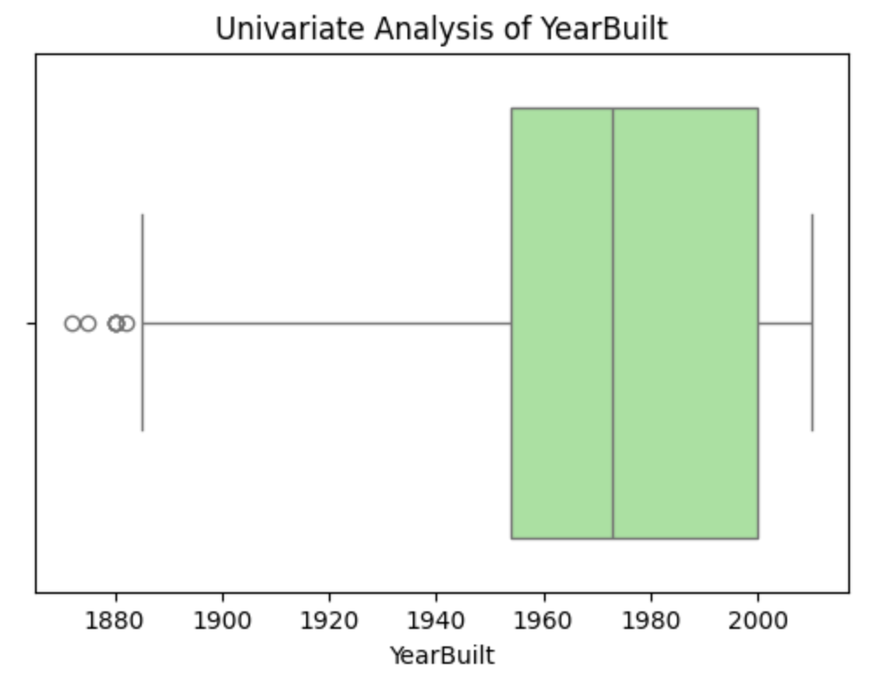
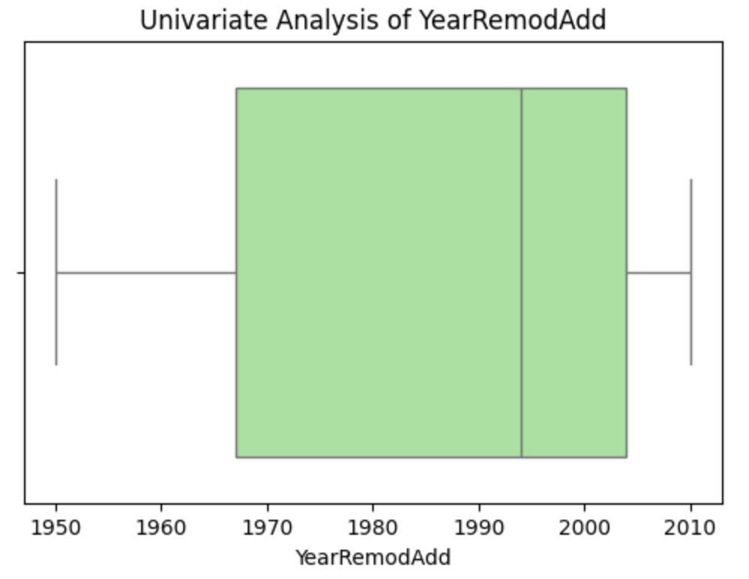
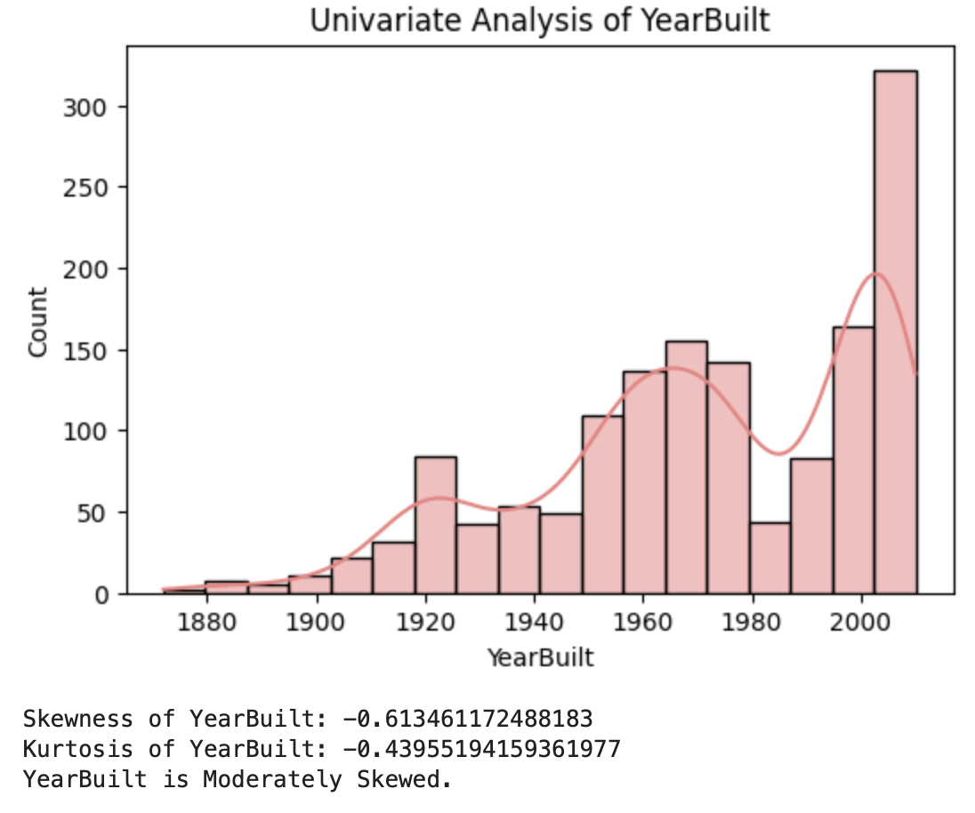
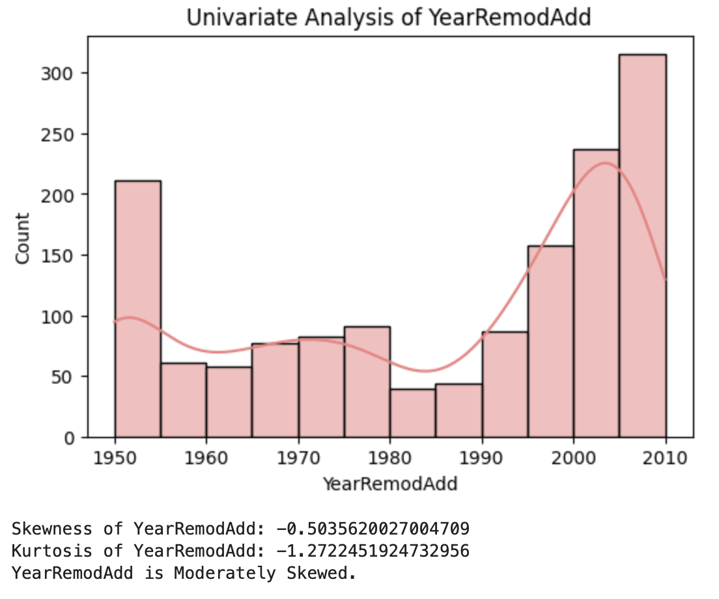
5. YearBuilt
Observed Pattern: Increased construction after 1950
Unusual Observations: Very old houses before 1900
Suburban expansion occurred in recent decades
6. YearRemodAdd
Observed Pattern: Remodeling activity increased in recent years
Unusual Observations: Few properties never remodeled
Insight: Renovations are common to maintain property value

Slide 7
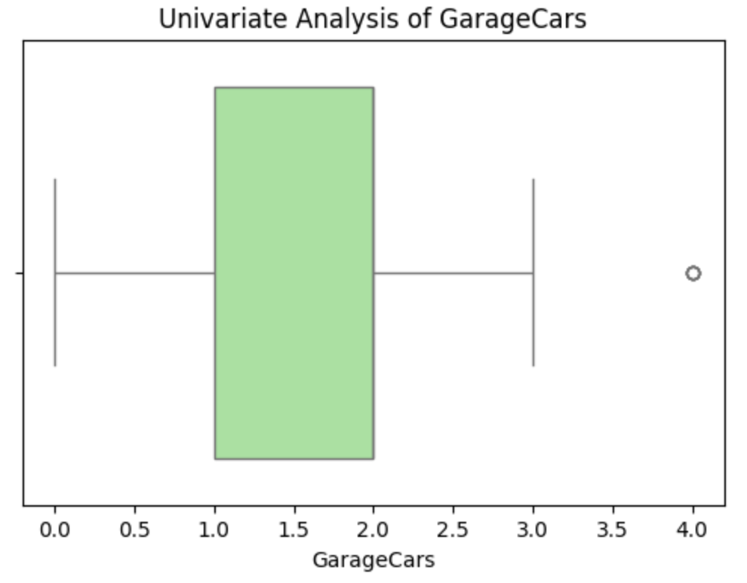
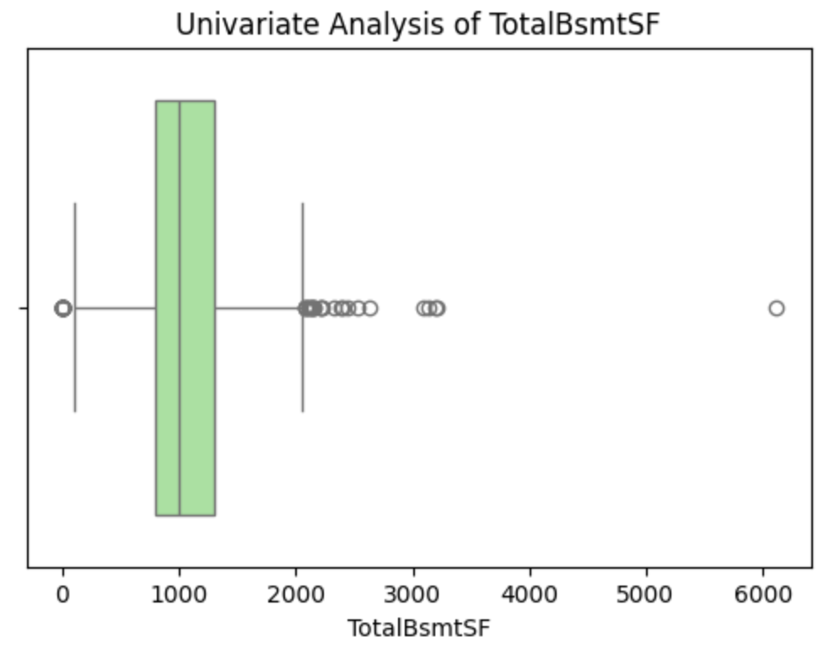
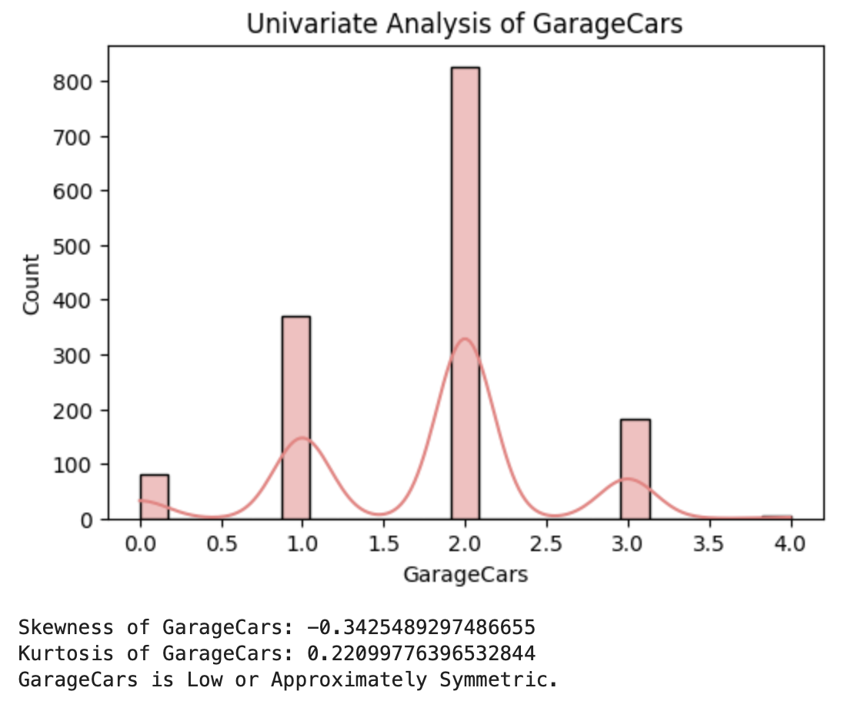
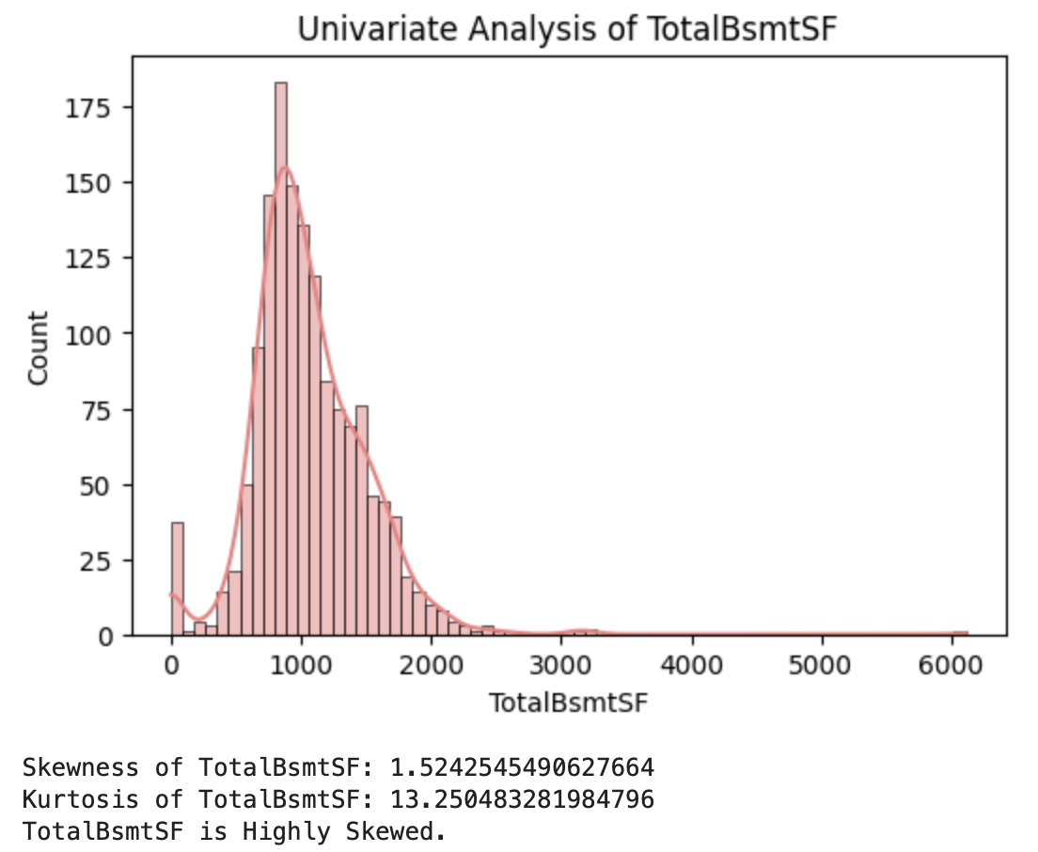
7. GarageCars
Observed Pattern: SalePrice increases strongly with garage capacity
Unusual Observations: Very large garages are rare
Insight: Parking capacity is a major price driver.
TotalBsmtSF
Observed Pattern: Right-skewed distribution
Unusual Observations: Some properties lack basements entirely
Insight: Basement size varies significantly and adds functional space

Slide 8
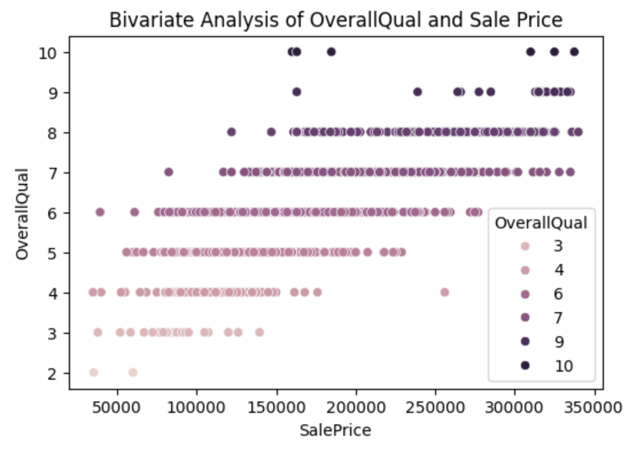
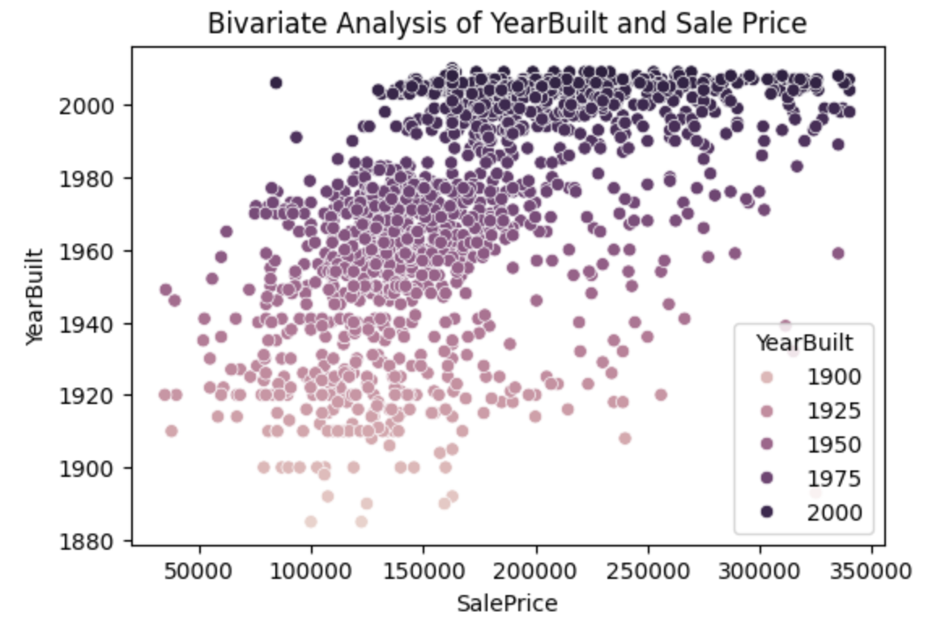
Bivariate Analysis
1. OverallQual vs SalePrice
Relationship: Strongest positive
Observed Pattern: Clear step-wise increase in SalePrice with higher quality ratings.
Insight: Best single predictor - reflects construction, material, and finish quality.
2. YearBuilt vs SalePrice
Relationship: Moderate positive
Observed Pattern: Newer houses generally sell at higher prices.
Insight: Modern construction and amenities add value.

Slide 9
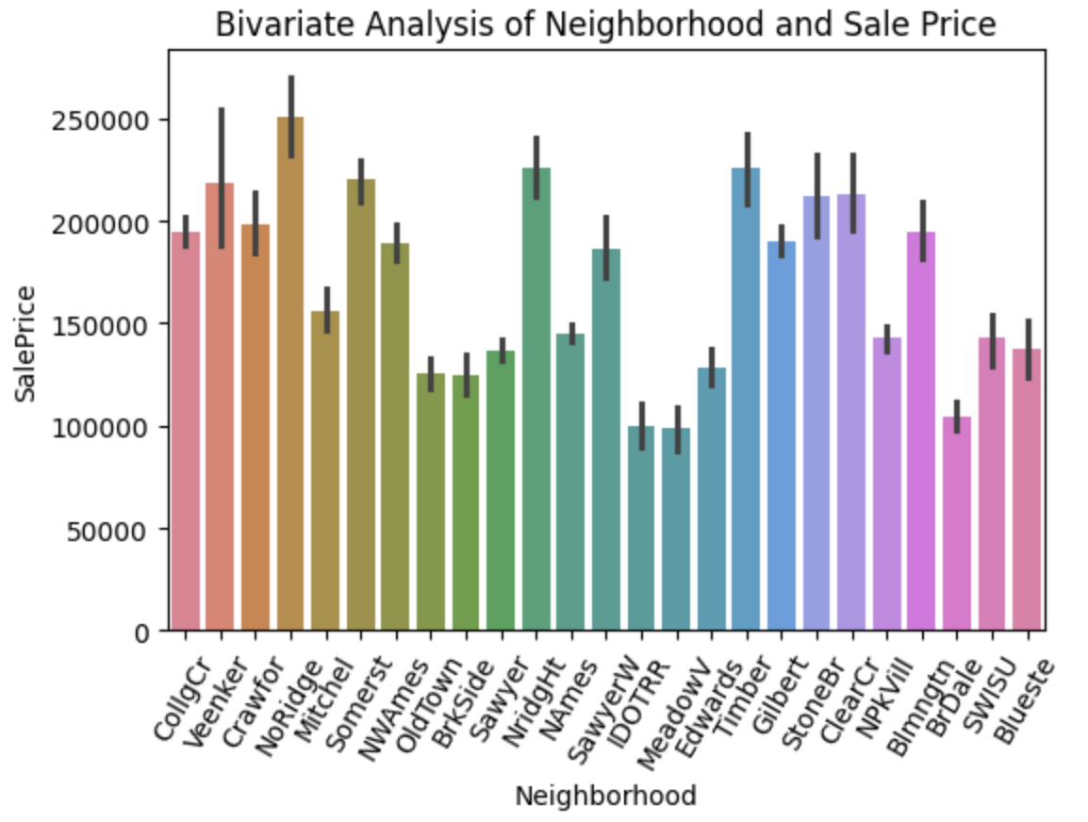
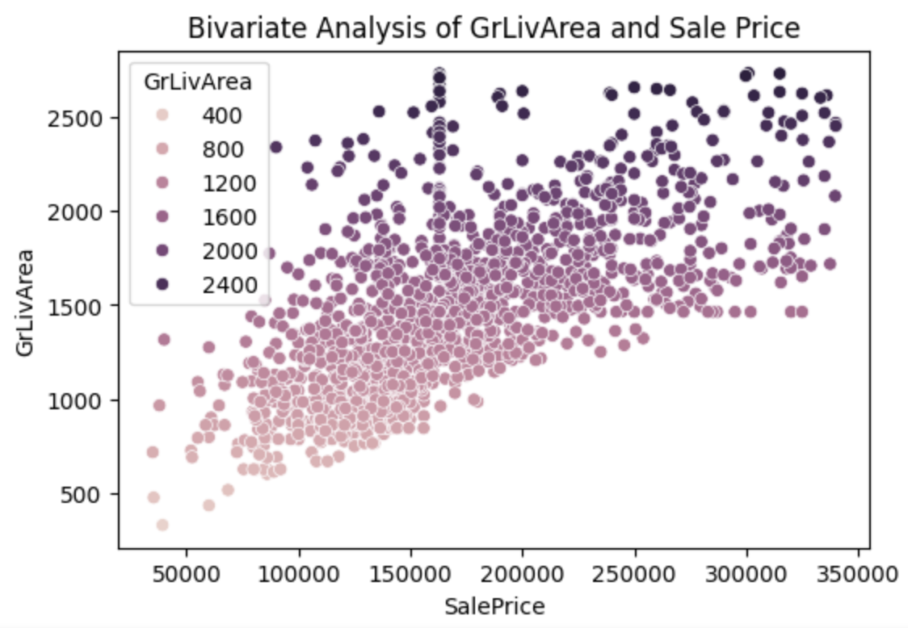
3. Neighborhood vs SalePrice
Pattern: Premium neighborhoods (e.g., NridgHt, StoneBr) show significantly higher SalePrice.
Insight: Location is one of the strongest determinants of property value.
4. GrLivArea vs SalePrice
Relationship: Very strong positive
Observed Pattern: Nearly linear upward trend with SalePrice.
Insight: One of the most important predictors — larger living area → higher price.

Slide 10
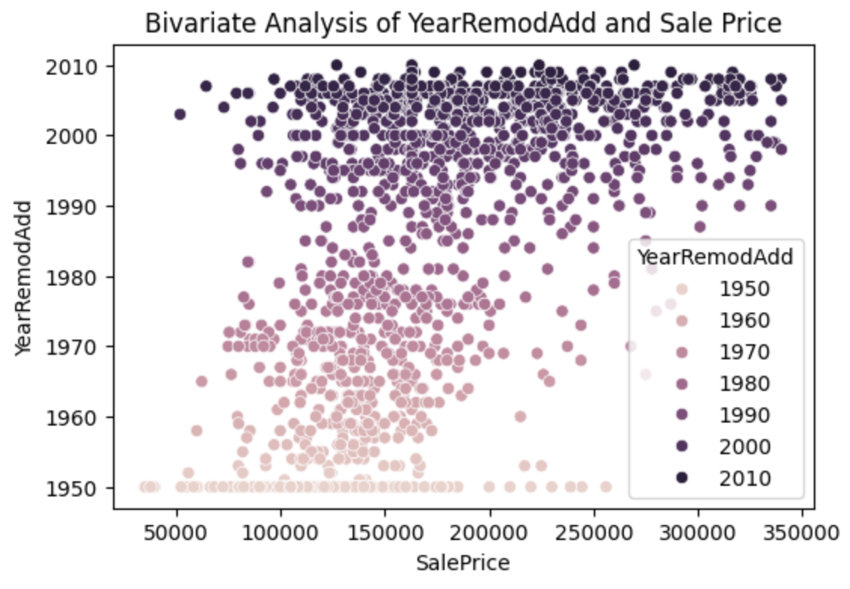
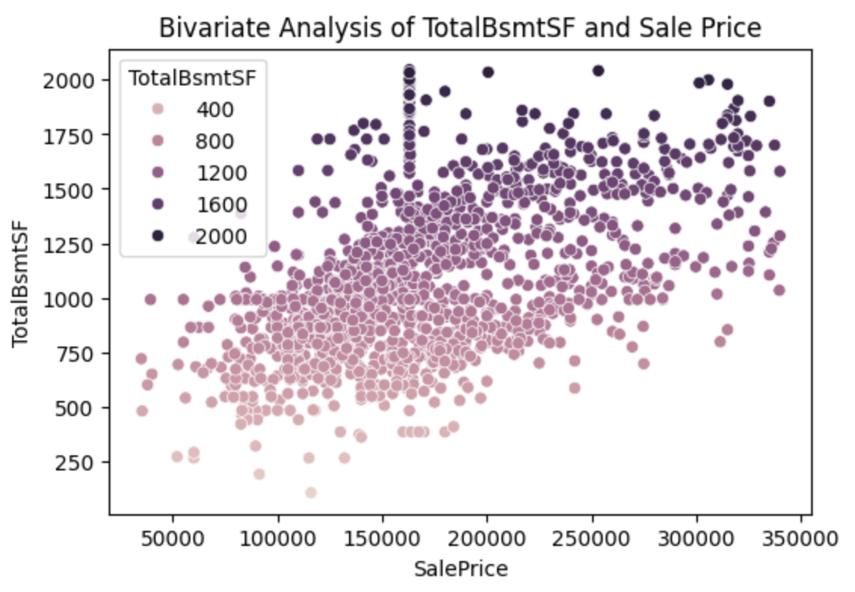
5. YearRemodAdd vs SalePrice
Relationship: Moderate positive
Observed Pattern: Recently remodeled homes sell for more.
Insight: Renovations improve perceived value.
6. TotalBsmtSF vs SalePrice
Relationship: Strong positive
Observed Pattern: Finished basements increase SalePrice significantly.
Insight: Adds usable living/storage space.

Slide 11
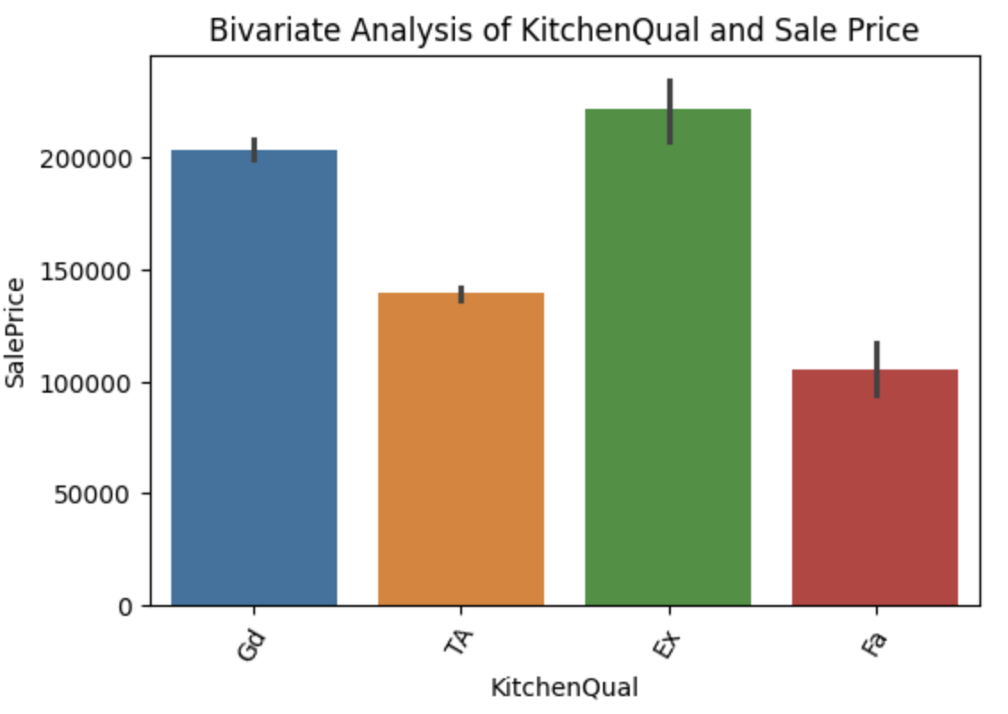
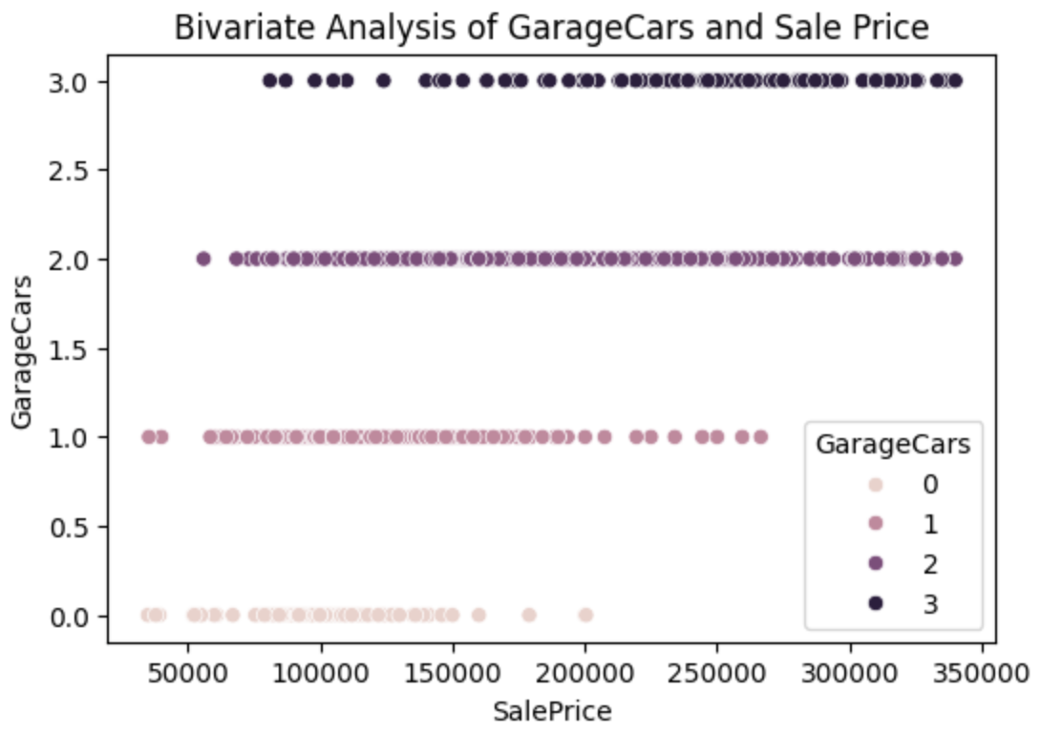
7. KitchenQual vs SalePrice
Pattern: One of the strongest categorical predictors of SalePrice.
Insight: Kitchen quality directly affects home valuation.
8. GarageCars vs SalePrice
Relationship: Strong positive
Observed Pattern: 2- and 3-car garages significantly increase SalePrice.
Insight: Parking capacity is a major selling point.

Slide 12
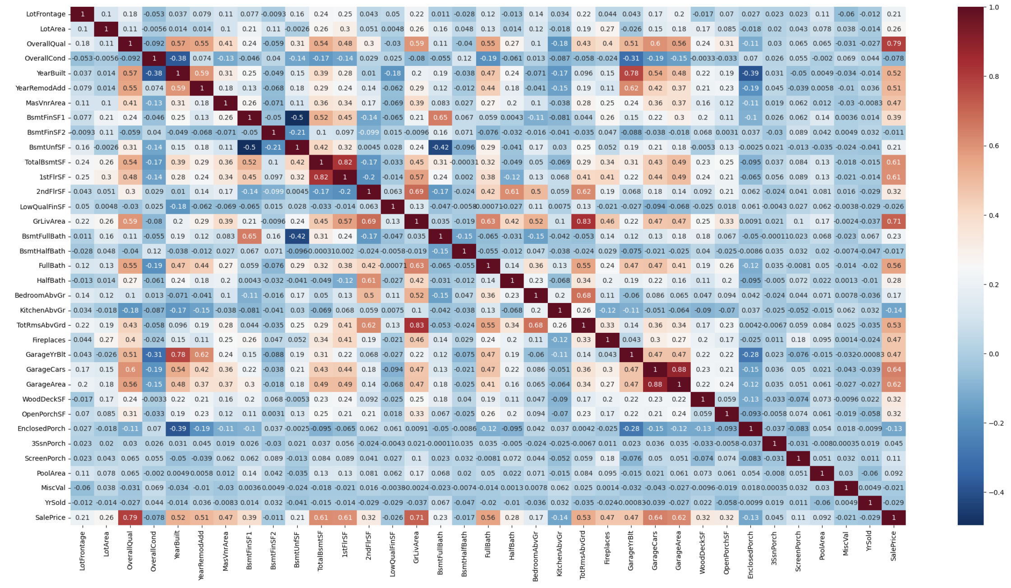
Multivariate Analysis
Heatmap of Correlations
Features:
1. Pairwise Pearson correlation between all numerical variables
2. Color intensity indicates strength of relationship
3. Diagonal values = 1 (self- correlation)
Observations:
> Strong positive correlation clusters:
1. GrLivArea, 1stFlrSF, 2ndFlrSF, TotRmsAbvGrd
2. TotalBsmtSF, BsmtFinSF1, BsmtUnfSF
3. GarageCars, GarageArea
> SalePrice has strong positive correlation with:
1. OverallQual
2. GrLivArea
3. GarageCars
4. TotalBsmtSF
5. 1stFlrSF
Insights:
The heatmap reveals strong multicollinearity among area and garage related variables, indicating redundant information that must be handled before model building.

Slide 13
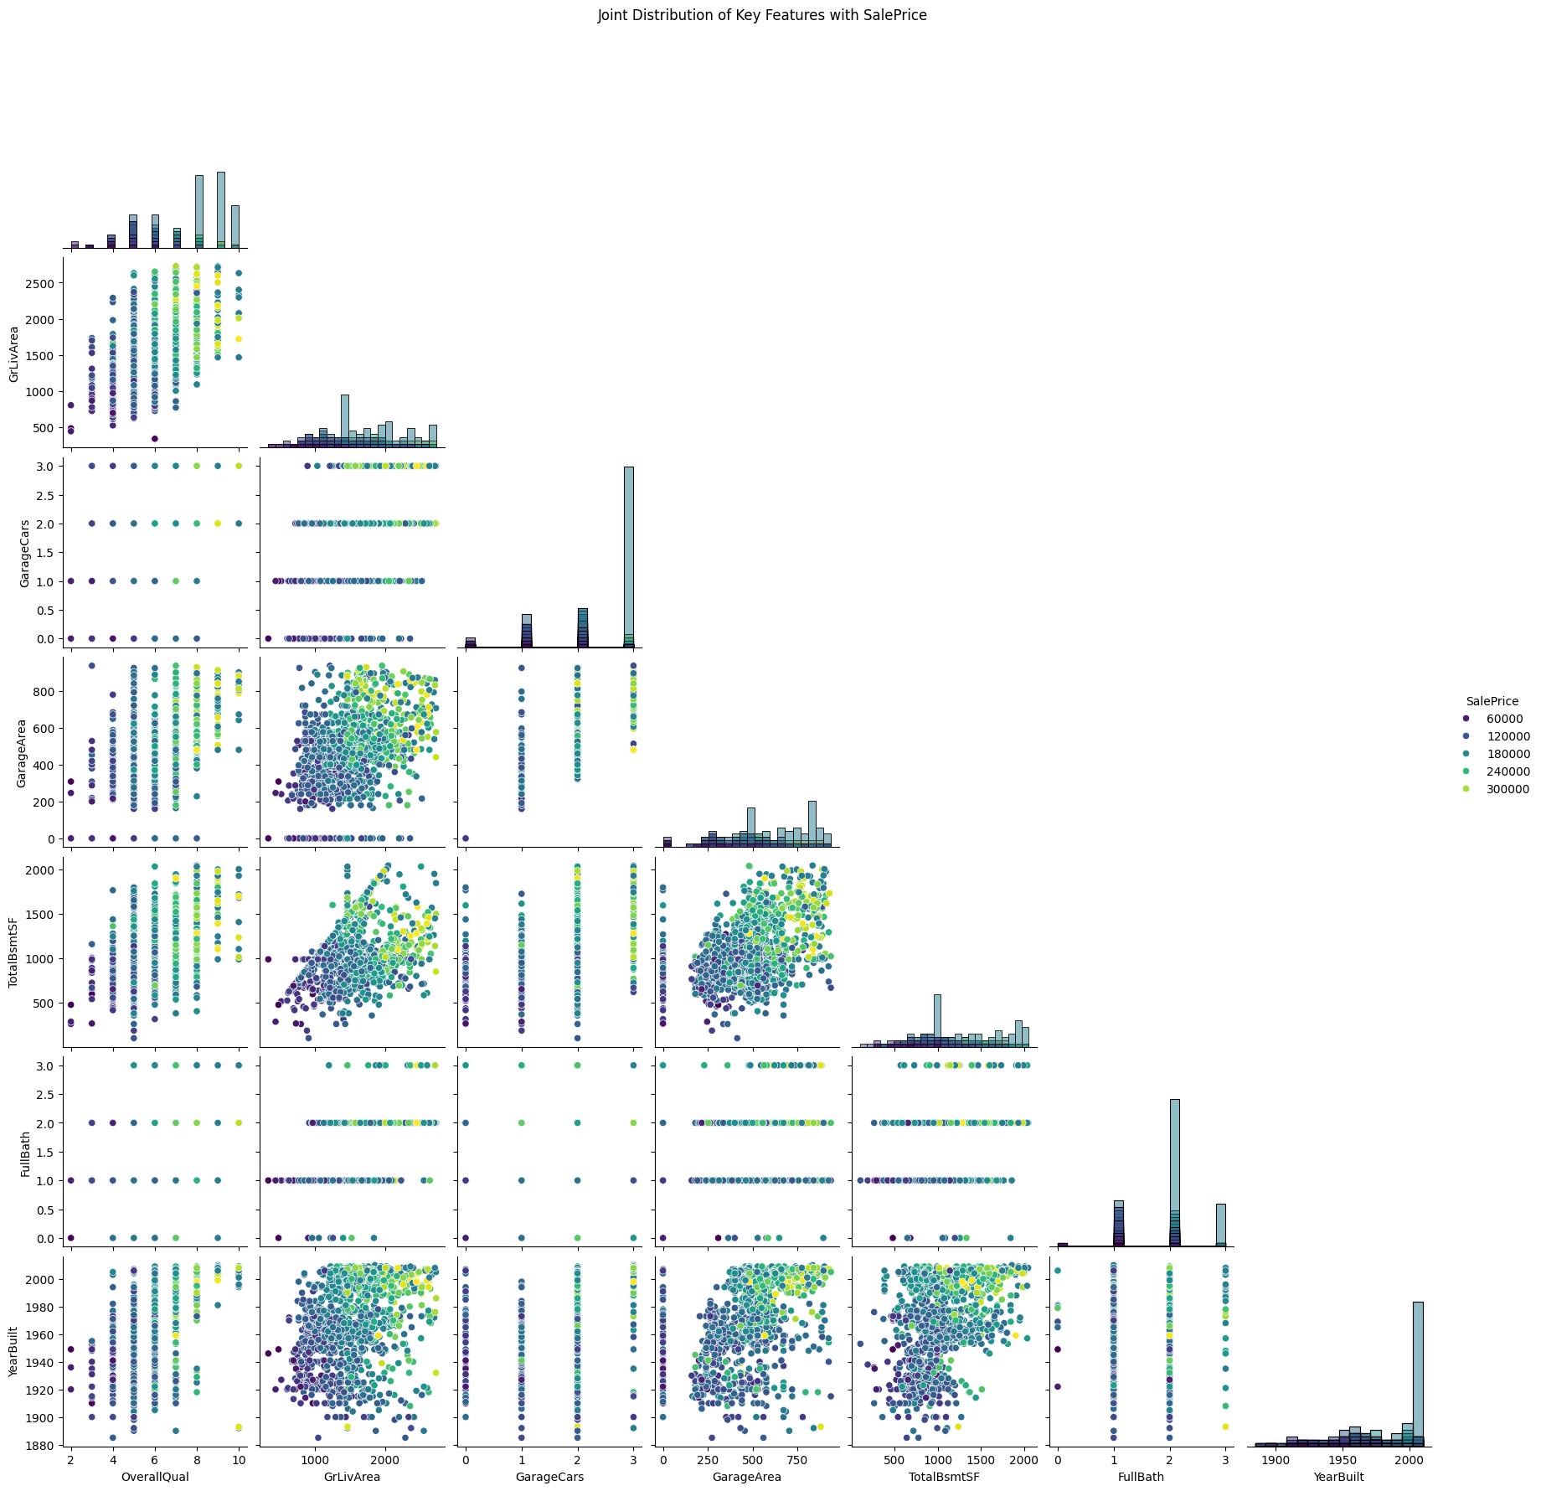
Jointplot
Insights for Jointplot:
The pair plot reveals strong positive relationships between SalePrice and OverallQual, GrLivArea, GarageCars, TotalBsmtSF, and FullBath. Size- and quality-related variables exhibit clear upward trends, confirming their dominant role in property pricing.
Conclusion for Jointplot:
Joint multivariate plots confirm that SalePrice is strongly driven by a combination of overall quality and usable living space. Garage capacity and basement area further amplify pricing, while temporal variables show comparatively weaker influence.

Slide 14
Finding and handling Outliers
In Real Estate Context:
Outliers often represent:
Luxury properties
Very large houses or plots
Exceptional amenities
Not all outliers are errors.
Outlier Detection Techniques Used:
Statistical Methods: Interquartile Range (IQR)
Impact of Outlier Treatment:
Before Handling: Skewed distributions, Inflated variance, Unstable model coefficients
After Handling: Improved linearity, Better model stability, More reliable predictions
Insights: I identified outliers using boxplots and IQR. Instead of removing all outliers, I retained valid luxury properties and treated only extreme anomalies using IQE method to improve model stability without losing business meaning.

Slide 15
Thank You !!

